Slide 1


DSA Kuppi 01
DATA STRUCTURES
& ALGORITHMS
1

Slide 2

DSA Kuppi 01
WHAT IS A DATA STRUCTURE?
Data structure is a specialized format for organizing, managing, and storing data to enable efficient access and modification. Data structures are fundamental components in computer science because they define how data is stored in memory, how relationships between data are maintained, and how data can be accessed and manipulated.
2

Slide 3


DSA Kuppi 01
KEY TYPES OF DATA STRUCTURES:
Linear Data Structures
Array: A collection of elements, each identified by an index.
Linked List: A sequence of nodes where each node contains data and a reference to the next node.
Stack: A collection of elements with Last-In-First-Out (LIFO) access.
Queue: A collection of elements with First-In-First-Out (FIFO) access.
Non-linear Data Structures
Tree: A hierarchical structure with nodes connected by edges, often used for hierarchical data.
Graph: A set of nodes connected by edges, which can represent various relationships.
Hash Table
A data structure that maps keys to values using a hash function for fast data retrieval.
Heaps
A specialized tree-based structure that satisfies the heap property, commonly used in priority queues.
3

Slide 4


DSA Kuppi 01
TODAY FOCUS
How to use Visual Studio - Basics
Basic C# coding snippets
Classes and OOP Recap
Basic Arrays
Dynamic Arrays
Insight to Linked-Lists
4

Slide 5

DSA Kuppi 01
OOP
Encapsulation
Abstraction
Polymorphism
Inheritance
4

Slide 6
DSA Kuppi 01
CLASSES
class is a blueprint or template that defines the properties (attributes) and behaviors (methods) that objects created from the class will have. A class is a foundational concept in OOP because it provides the structure for creating individual instances, or objects, that contain data and can perform specific actions.
5

Slide 7


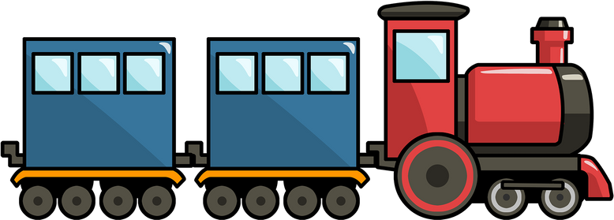
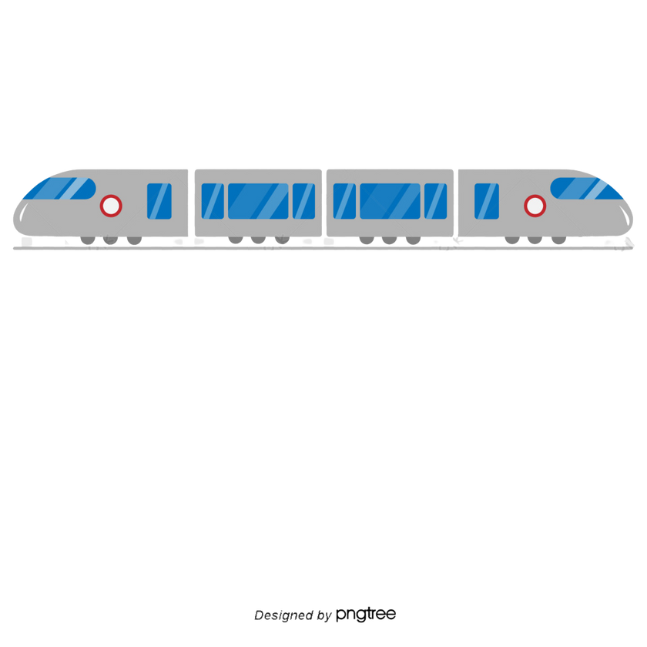
ARRAYS
DSA Kuppi 01
ARRAY
DYNAMIC ARRAY
LINKED LIST
6

Slide 8

DSA Kuppi 01
THANK
YOU!
LINK
7

